Slide 1

SkillCourt v8.0
Team Members: David Schiumerini, Richard Rodriguez Product Owner: Guðmundur Traustason
Instructor: Masoud Sadjadi School of Computing and Information Sciences Florida International University
Final Presentation
Summer 2017
Notes:
7 seconds.( I will select 2 best slides (i will give them extra points and students will present for CIS committee)
Greet your audience, thank them for attending your presentation, introduce yourself, introduce your project, introduce your team members, and quickly indicate what each of you did in a high-level manner, and put more emphasis on your part/contribution.

Slide 2
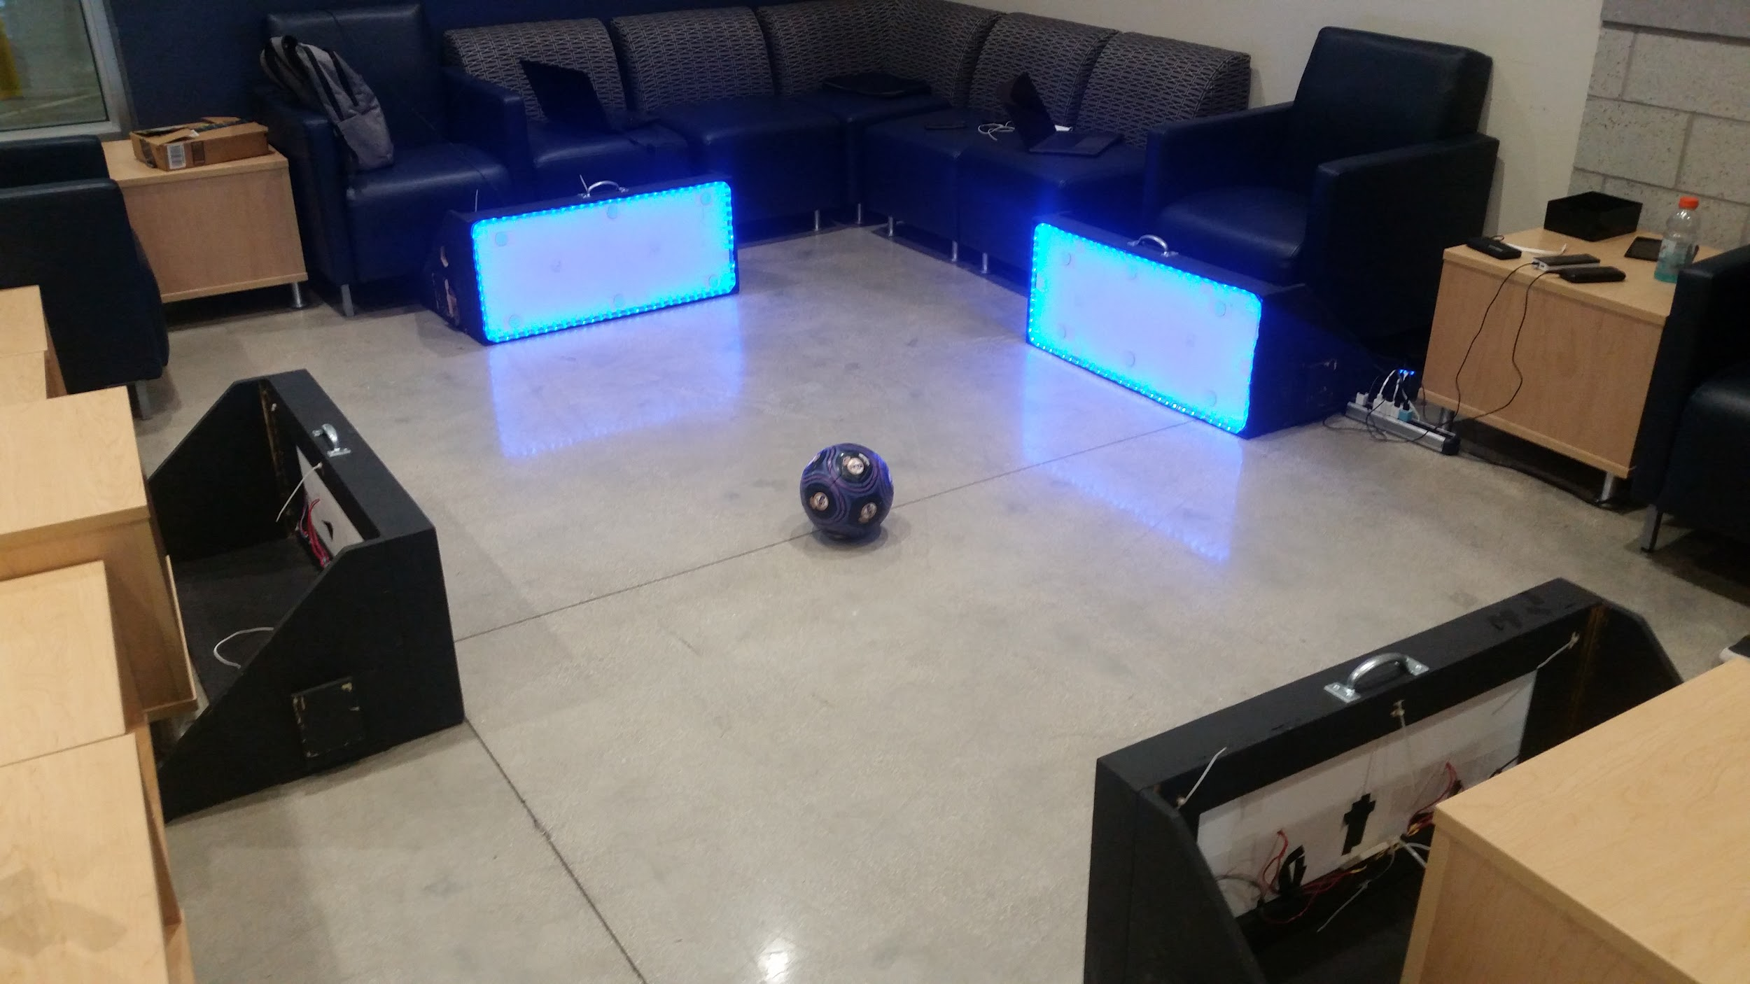
Project definition
SkillCourt provides a platform for users that seek to enhance their traditional training methods in the sport of Soccer. Through neat features that record hit accuracy, reaction time, and much more; players are given an innovative way to better improve their performance on the field.
Notes:
10 seconds.
Introduce the problem that the whole project (in all versions) tackles with GIF or screenshot.

Slide 3
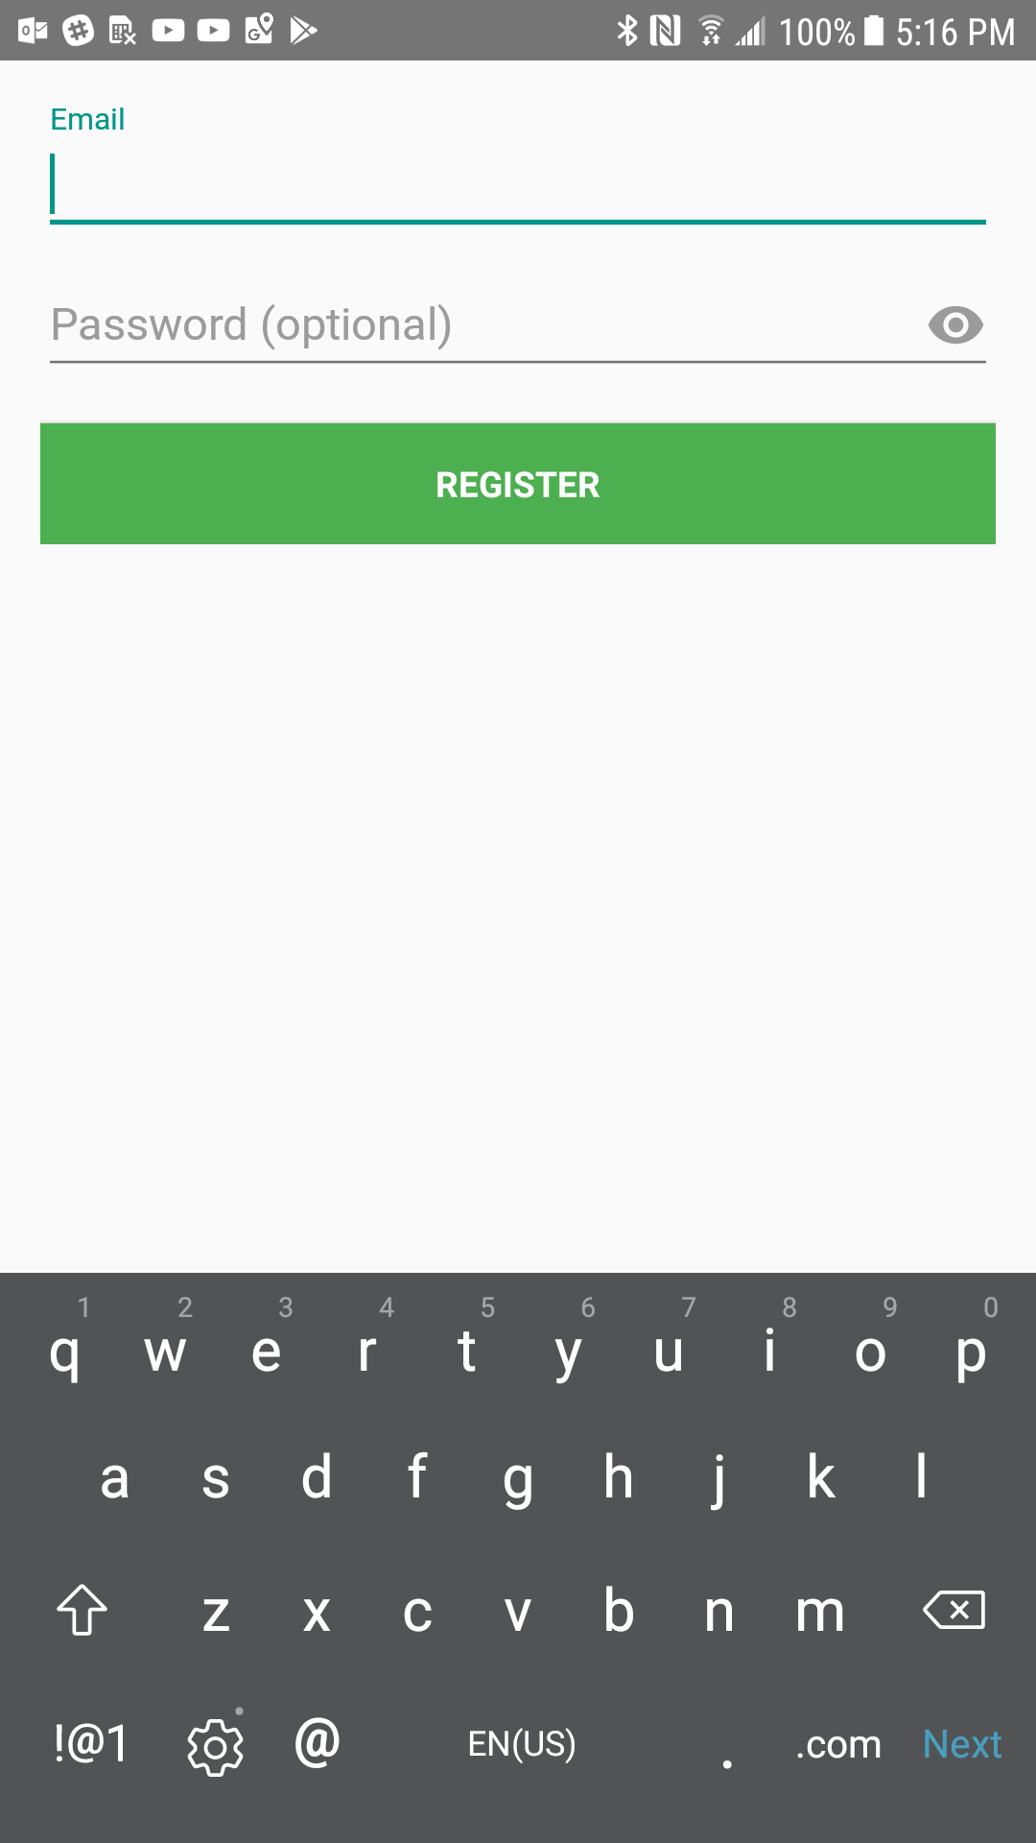
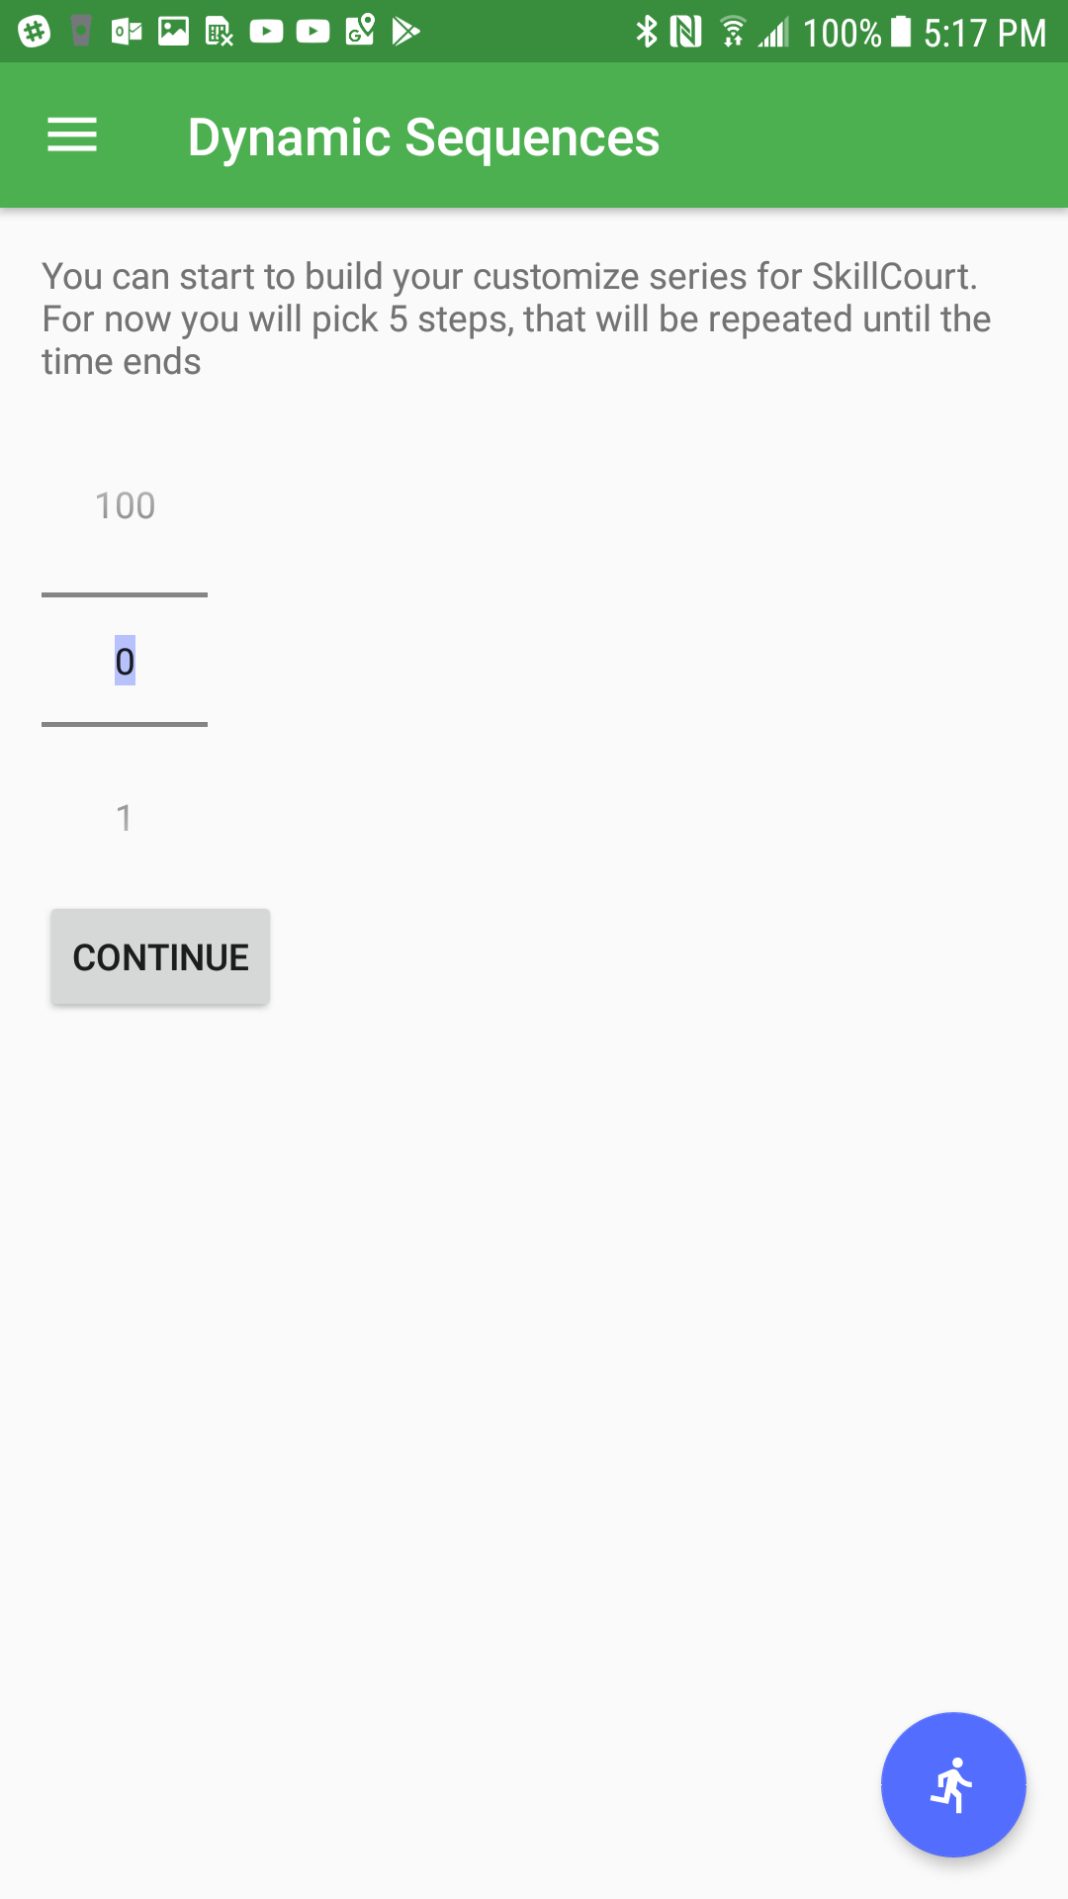
Project definition
Currently there really wasn’t any customization in regards to user accounts, registration page (shown below) only asks for an email and “Password (optional).” Accounts should register more personal information including the ability to choose between a Coach or Player account upon creation. Also the former game sequence creating system was unreliable and out of date and needed an overhaul.
Notes:
20 seconds.
Introduce the problem that the your project (in new version) tackles with GIF or screenshot.

Slide 4
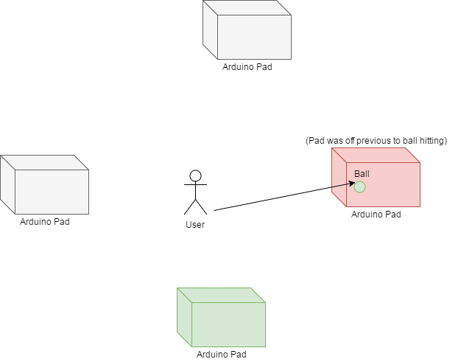
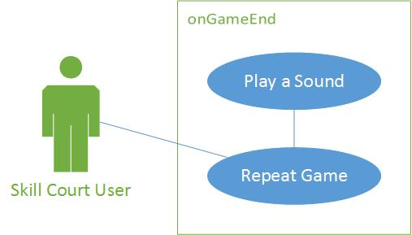
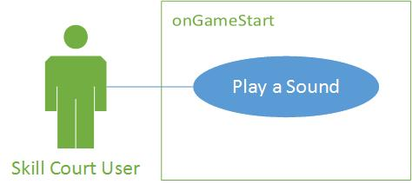
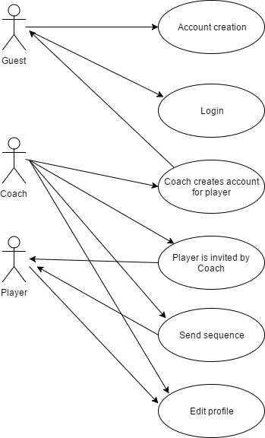
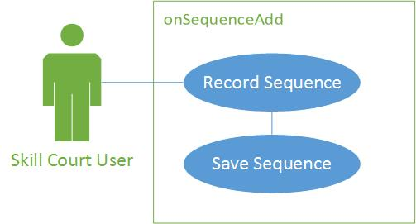

Requirements: Use Cases
Notes:
5 seconds
Show the Use Case Diagram for the whole project. Highlight your use cases.

Slide 5
System Design: Architecture
System decomposition (3 systems at work)
Microcontroller Unit (MCU)
Android Controller
Firebase Database
System Deployment
A system capable of running Android OS v3.0 or higher
Android v3.0 or higher
Minimum of two SkillCourt Arduino Game Pads
Access to the Internet
Notes:
20 seconds
System design: Highlight the parts that you contributed to them.
1. System decomposition; identify the architecture patterns used
2. System deployment – h/w and s/w requirements

Slide 6
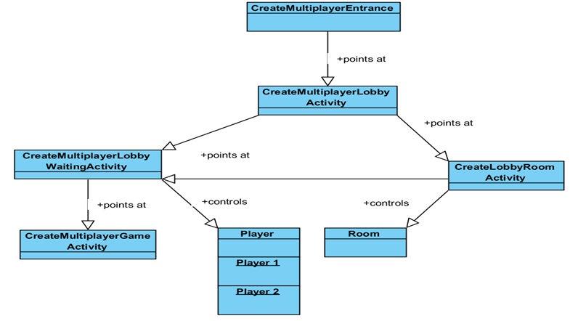
Minimal Class Diagram
Notes:
10 seconds.Minimal class diagram. Highlight the classes that you created/modified
Identify the design patterns used (one or more slides).

Slide 7
User Stories
Save Battery
Game Sounds
Predetermined Sequences
Set-up Accounts
Connect Directly to Arduino
Notes:
5 seconds.
List the user stories that you worked on them.(put in order of importance). Stay focused on the parts that you have been working.

Slide 8
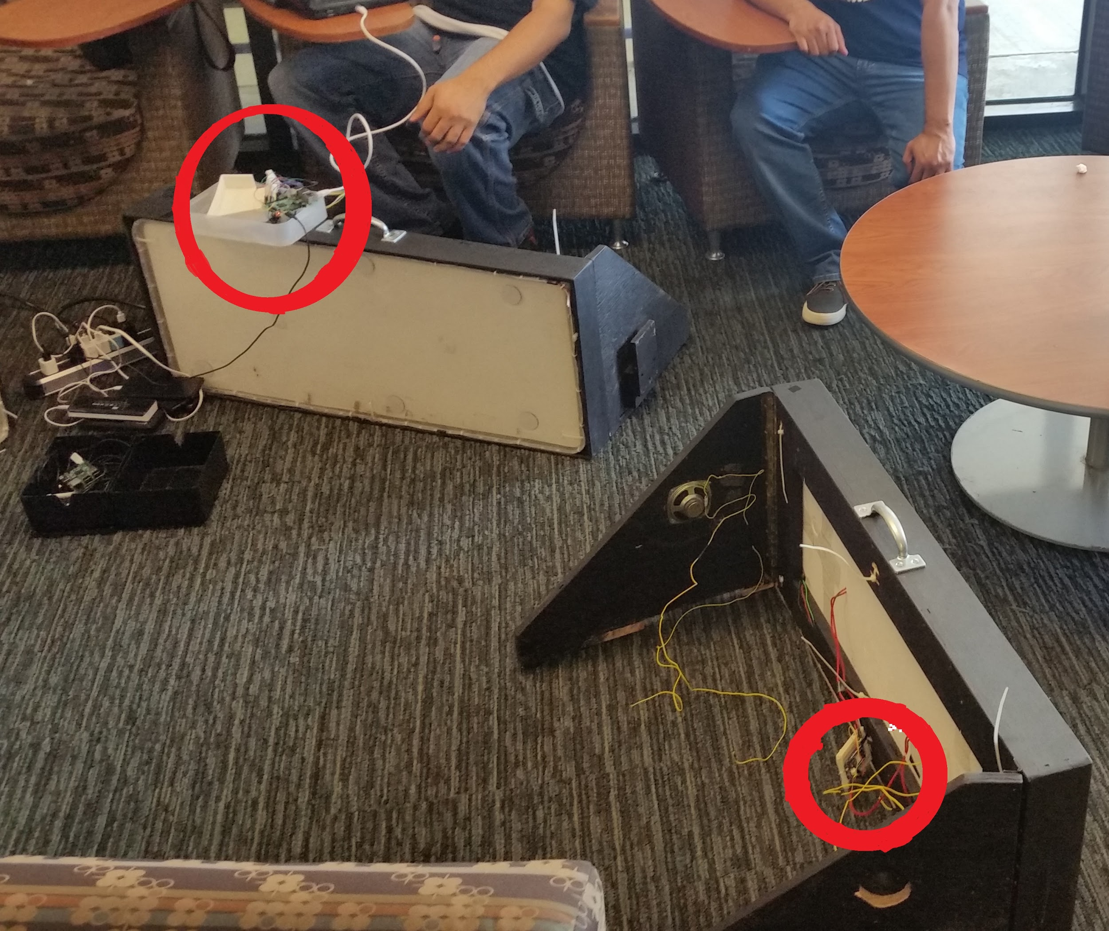
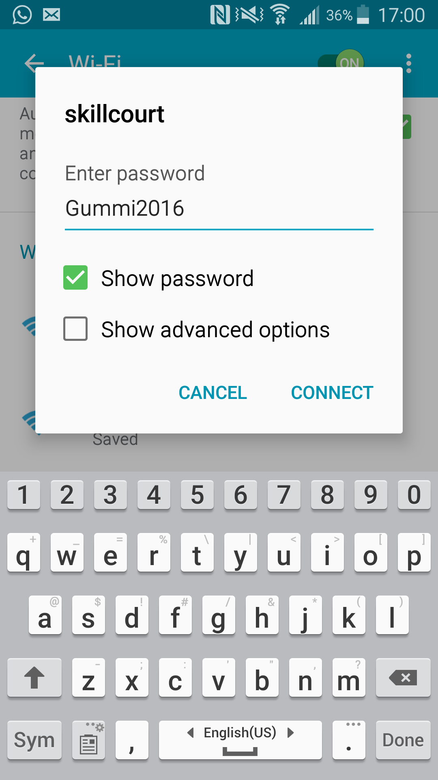
Connect directly to Arduino
Description:
Previously the Arduino hardware will connect via wifi to an rPi device that sent out a wifi hotspot. This was unnecessary and costly for production. To cut costs we were tasked to bypass the need for a raspberry pi by having the Android app connect to the Arduino pads directly.
Notes:
60 seconds
The tile of user story
The most important user story you worked on it. You have to describe this one very well and be proud of that.
Please present and show the complexity of your work, code, algorithms, and technical challenges and technologies you have used. (you could use screenshot if you want. Visual presentations are better than text presentation)
Go into the details of the most important/significant tasks using bullet lists or visual graphs or state chart diagram
Sequence Diagram for this user story is mandatory (in another separate page if required)
Demo using screenshots or GIF (in another separate page if required)

Slide 9
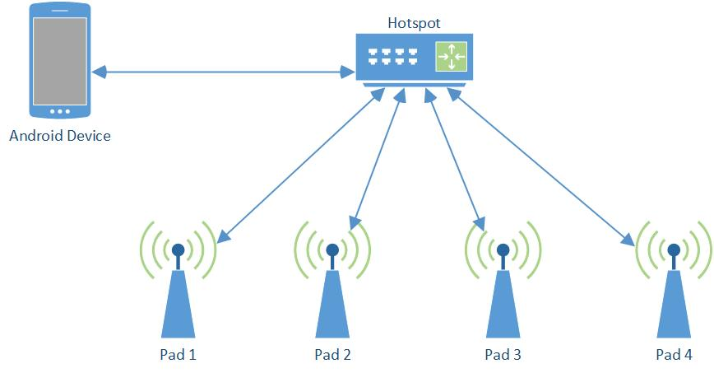
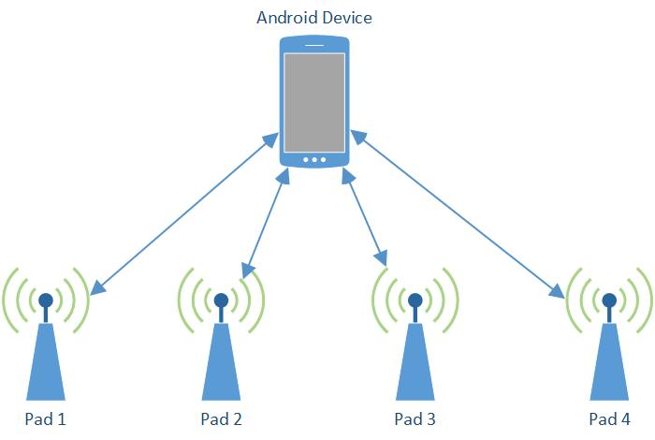
Previous version
Current version

Slide 10
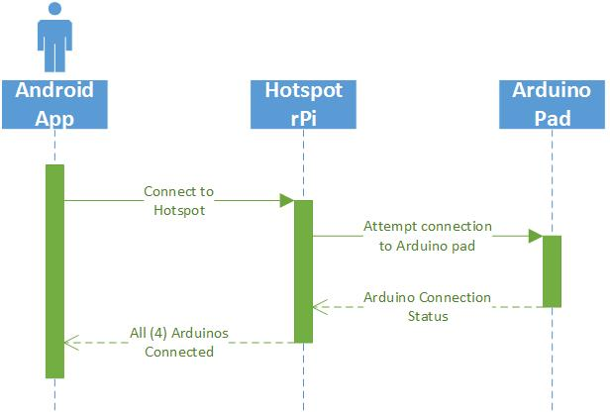
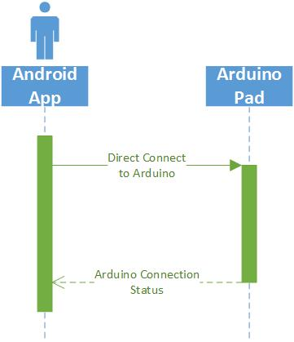
Previous version
Current version

Slide 11
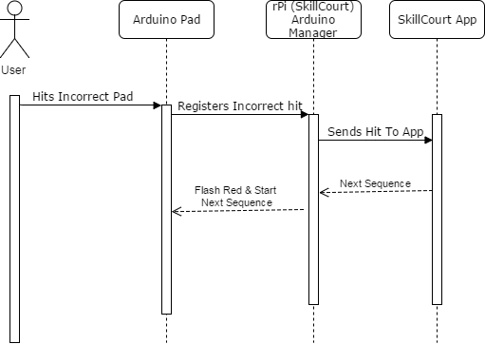
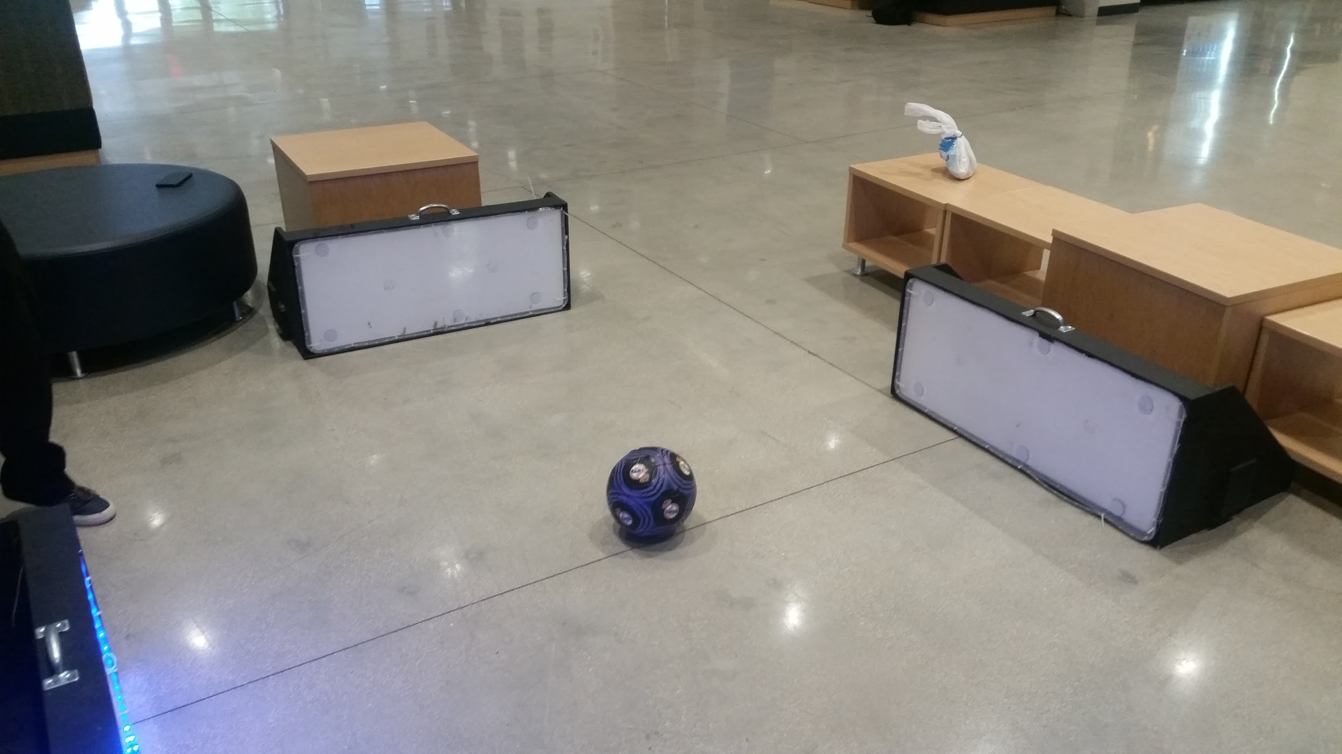
Save Battery
Description:
Previously when playing a game the pads that you are supposed to hit lit up green and all the others red, wasting a lot of battery life. To combat this these red lights were now set to be off and would flash red when incorrectly struct to provide user feedback of his/her input.
Notes:
20 seconds
The tile of user story
Please present and show the complexity of your work, code, algorithms, and technical challenges and technologies you have used. (you could use screenshot if you want. Visual presentations are better than text presentation) - Go into the details of the most important/significant tasks using bullet lists or visual graphs or state chart diagram - Demo using screenshots or GIF (in another separate page if required)
Sequence Diagram for this user story is optional

Slide 12
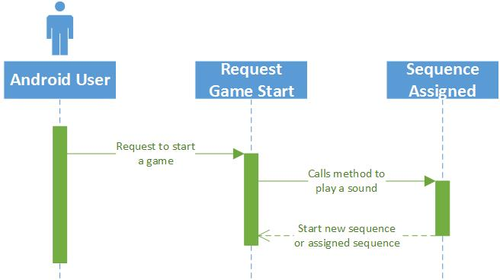
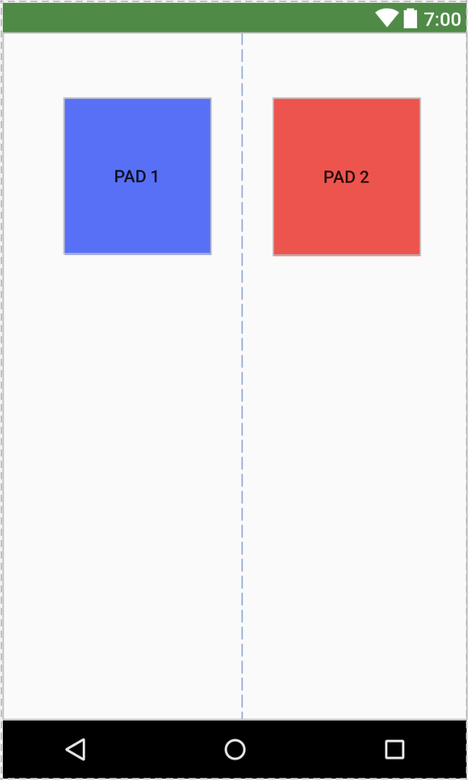
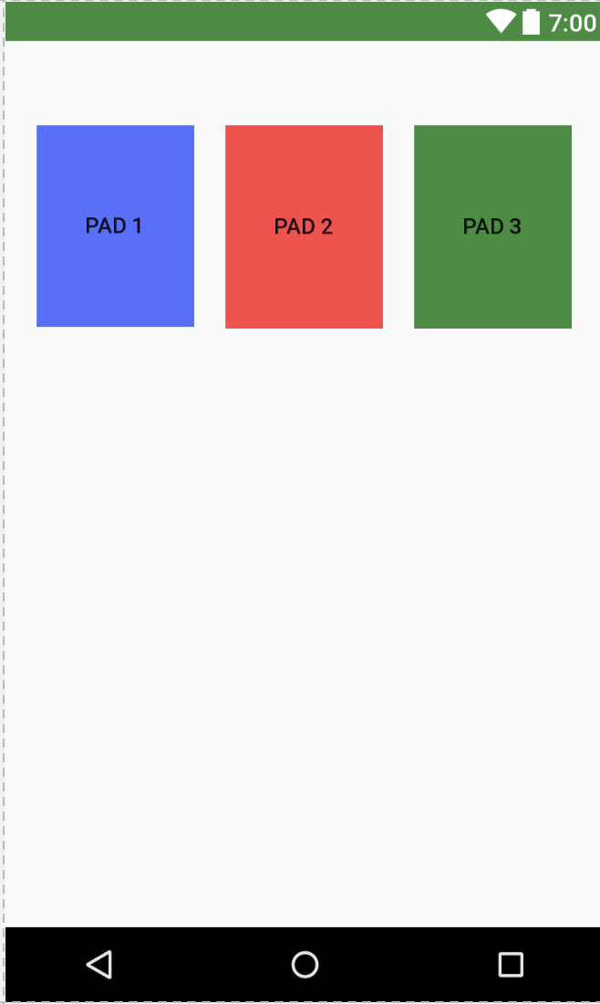
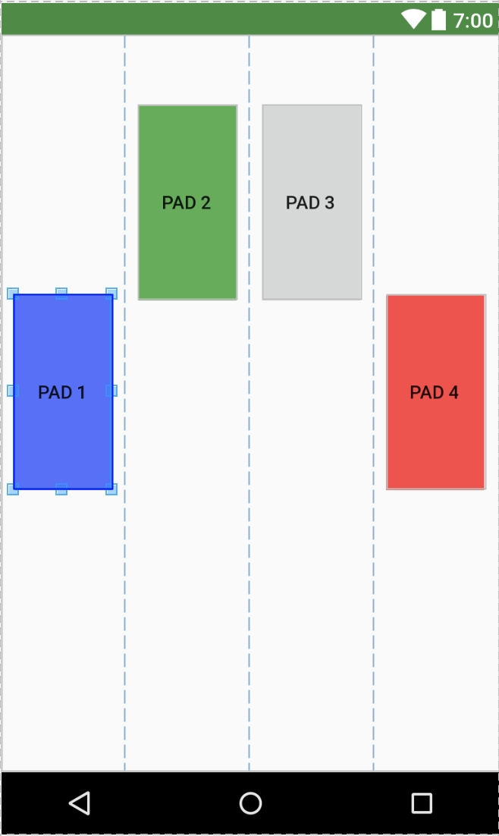
Predetermined Sequences
Description:
Allows for a user to record a predetermined sequence so that it can be used by other users to train their skills.
Notes:
20 seconds
The tile of user story
Please present and show the complexity of your work, code, algorithms, and technical challenges and technologies you have used. (you could use screenshot if you want. Visual presentations are better than text presentation) - Go into the details of the most important/significant tasks using bullet lists or visual graphs or state chart diagram - Demo using screenshots or GIF (in another separate page if required)
Sequence Diagram for this user story is optional

Slide 13
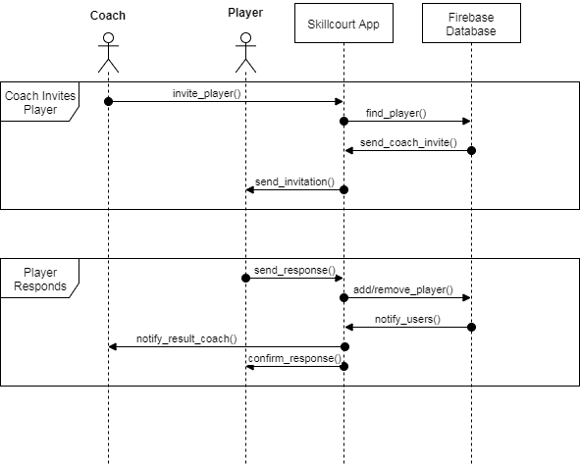
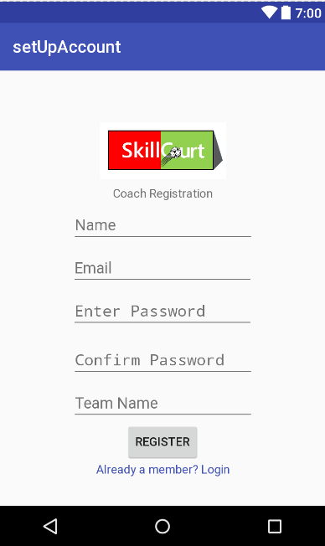
Set-Up Accounts
Description:
Allows for a User to upgrade their account to Coach role.
Coach role allows the ability to maintain a team of Players (regular users) where he could manage their training methods by sending game patterns (defined as Predetermined Sequences) and having the ability to view their match history to develop the best training regiment for each Player.
Coaches will also have the ability to create accounts for unregistered players or invite currently existing accounts to his/her team.
Notes:
20 seconds
The tile of user story
Please present and show the complexity of your work, code, algorithms, and technical challenges and technologies you have used. (you could use screenshot if you want. Visual presentations are better than text presentation) - Go into the details of the most important/significant tasks using bullet lists or visual graphs or state chart diagram - Demo using screenshots or GIF (in another separate page if required)
Sequence Diagram for this user story is optional

Slide 14
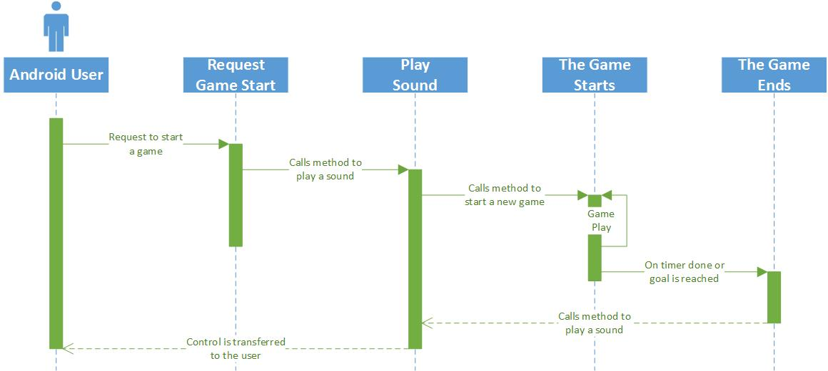
Game Sounds
Description:
Allows the system to produce an audible acknowledgement to inform the user that the game is about to start.
Notes:
20 seconds
The tile of user story
Please present and show the complexity of your work, code, algorithms, and technical challenges and technologies you have used. (you could use screenshot if you want. Visual presentations are better than text presentation) - Go into the details of the most important/significant tasks using bullet lists or visual graphs or state chart diagram - Demo using screenshots or GIF (in another separate page if required)
Sequence Diagram for this user story is optional

Slide 15
Test Suites and Test Cases
Test case ID: 001 Description: To save battery life of the pads. Actual Result: Worked Status (Fail/Pass): Pass
Test case ID: rPiBypass001 Description: Testing for a direct connection from the Android App to the Arduino, bypassing the Raspberry Pi.. Actual Result: Did not connect. Status (Fail/Pass): Fail
Notes:
10 seconds
A description of verification process and Test Suites and Test Cases for one of the use cases.
1 One sunny day and one rainy day for the implemented use cases (one or more slides).
2 Automated test scripts for the implemented use cases (if any) (one or more slides).

Slide 16







Summary
Throughout this semester, David Schiumerini and Richard Rodriguez worked on the Android application with the help of a couple of the product owners past developers. We would regularly meet with these mentors to further reach Mr. Traustason’s goals for SkillCourt.
● David Schiumerini – dschi002@fiu.edu
● Richard Rodriguez – rrodr420@fiu.edu
Notes:
10 seconds
Summarize your contribution, mention your effort for Scrum, Mingle, Github, Google Drive Documentation and minutes
Include your contact information
Ask if anyone has any questions for you.
Thank your audience

